Slide 1

CSIS-210 Data Structures
Lecture 3: Generic Types and the Stack ADT
Fall 2016
zyBook assignment on Monday, bring laptops

Slide 2
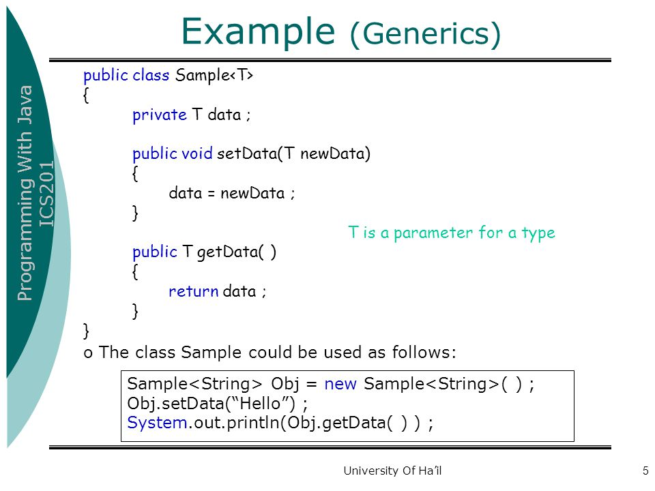
Generic Types: Review

Slide 3
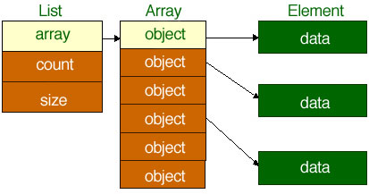
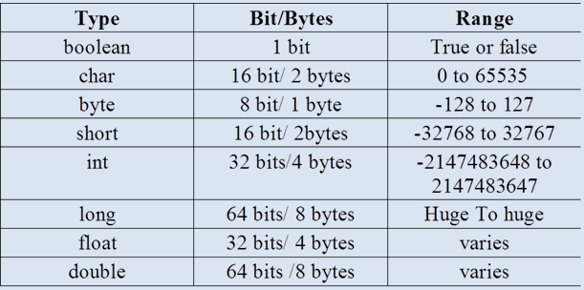
Generic Types: Review

Slide 4

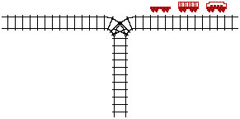
Consider the following applications:
(1) Model the discard pile in a card game
(2) Model a railroad switching yard

Slide 5
In these problems we need a
"last-discarded-first-removed,"
"last-pushed-onto-first-removed,"
"last-stored-first-removed, "
"last-generated-first-displayed"
structured data type.
In summary ... a LIFO (Last-In-First-Out) structure.
Other examples?

Slide 6
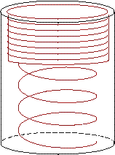
Stack as an ADT
Adding a plate pushes those below it down in the stack
Removing a plate pops those below it up one position.

Slide 7
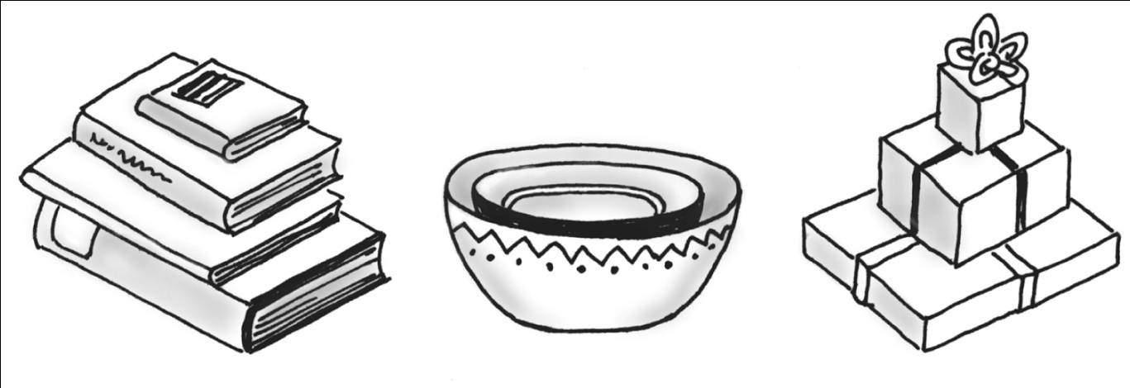
Specifications of the Stack ADT
Organizes entries according to order in which added (also enforces rules)
Additions are made to one end, the top
The item most recently added is always on the top

Slide 8
Specifications of the ADT Stack
Abstract Data Type Stack – general operations
HOW these are done is not specified
WHAT operations is specified
Interface lists method signatures
push(newEntry)
T pop()
T peek()
boolean isEmpty()
void clear()

Slide 9
ABSTRACT DATA TYPE RULE:
Behavior (interface) must be independent of class implementation.
In a manner independent of any specific representation of object (because we have no idea of what data members will be available).

Slide 10
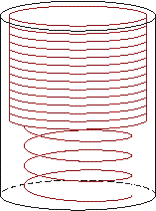
A stack is an ordered collection of data items in which access is possible only at one end (called the top of the stack).
Basic operations:
1. Construct a stack (usually empty)
2. Check if stack is empty: boolean isEmpty( )
3. push(entry) : Add an element at the top of the stack
4. x = peek( ) : Retrieve the top element of the stack
5. x = pop( ) : Remove the top element of the stack
6. clear( ) : Make the stack empty
7. What about isFull() ?

Slide 11
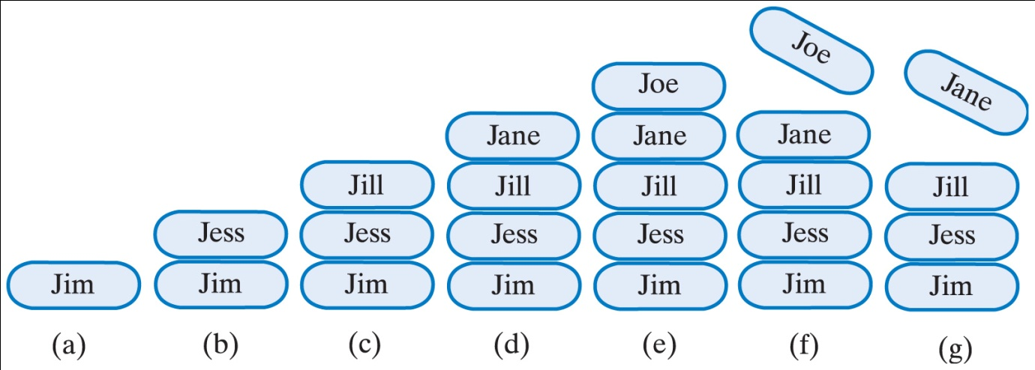
A stack of strings after (a) push adds Jim; (b) push adds Jess; (c) push adds Jill; (d) push adds Jane; (e) push adds Joe; (f) pop retrieves and removes Joe; (g) pop retrieves and removes Jane

Slide 12
Example application code
Stack<String> myStack =new Stack<String>();
myStack.push(“A”);
myStack.push(“B”);
System.out.println(myStack.pop( ) );
System.out.println(myStack.peek( ) );
If (!myStack.isEmpty( ) )
System.out.println(myStack.pop( ) );

Slide 13
An Array-Based Implementation
When using an array to implement a stack
The array's first element should represent the bottom of the stack
The last occupied location in the array represents the stack's top
This avoids shifting of elements of the array if it were done the other way around

Slide 14
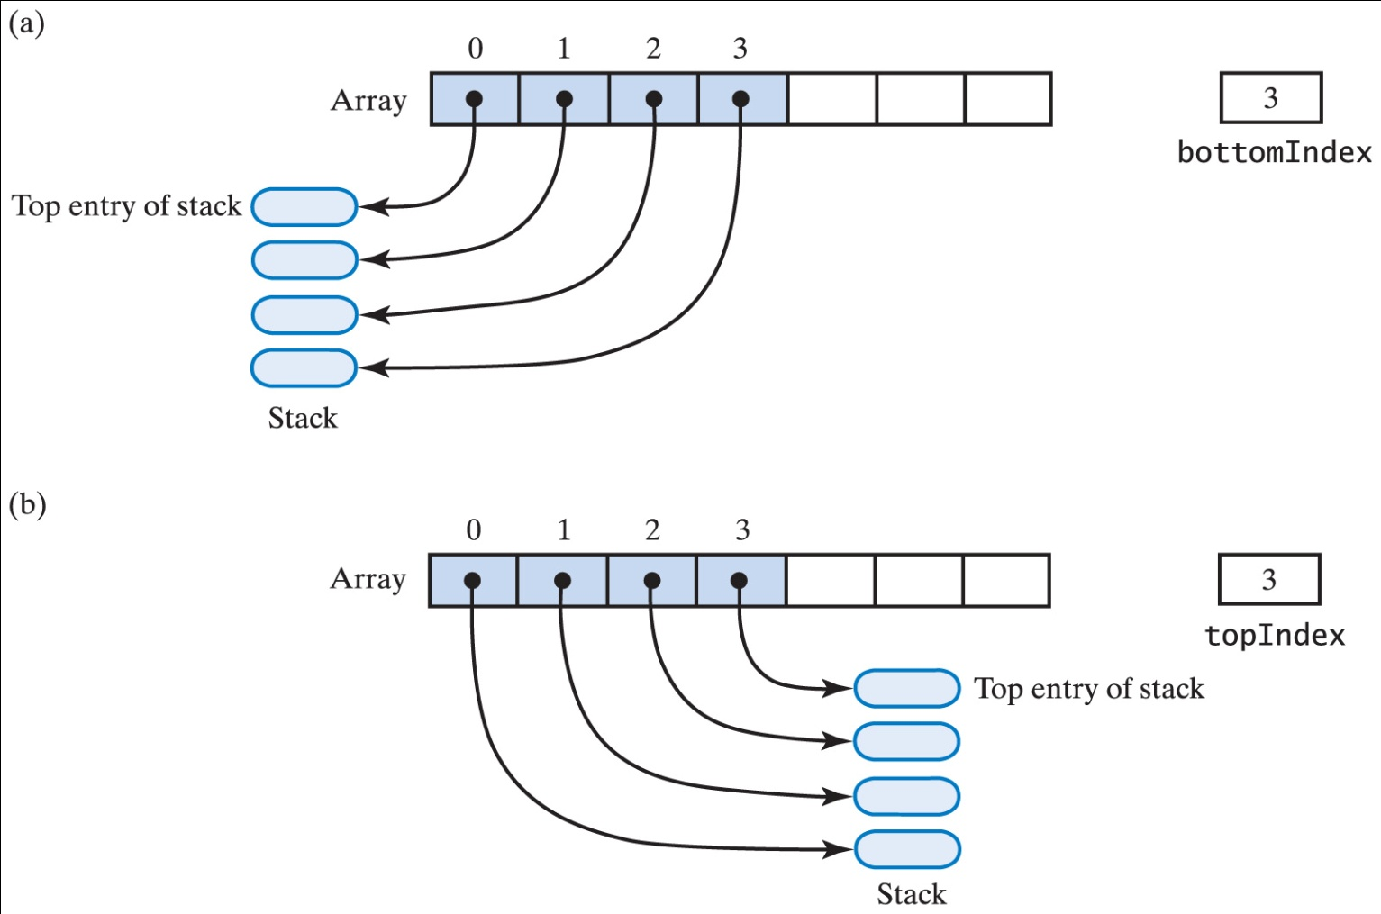
Alternative Array-Based Implementations of a Stack

Slide 15
Push 75
Push 89
Push 64
Pop
0
0
75
0
89
0
64
0
89
1
1
1
75
1
89
1
75
2
2
2
2
75
2
3
3
3
3
3
4
4
4
4
4
Works, but : Not efficient to shift the array elements up and down in the array. SLOW !!!
How much work is involved with this?
For stack with N (where N is large) elements in it.
The computational complexity.

Slide 16
An Array-Based Implementation
public class ArrayStack implements StackInterface<T>{
private T[ ] stack; //ARRAY OF STACK ENTRIES
stack = new (T [ ] ) new Object[size] // Cast to generic type
private int topIndex; //INDEX OF TOP ENTRY
private static final int DEFAULT_INITIAL_CAPACITY = 50;
Write methods
Constructor() and Constructor(size)
push
peek
pop
isEmpty

Slide 17

Implementing Stack Class — Refined
Keep the bottom of stack at position 0. Maintain a "pointer" myTop to the top of the stack.
Note: No moving of array elements. “Constant time”
The interface remains the same regardless of implementation!

Slide 18
Implementing Stack Class — Refined
Keep the bottom of stack at position 0. Maintain a "pointer" myTop to the top of the stack.
myTop→
myTop→
myTop→
myTop→
myTop→
myTop = -1
myTop = 0
myTop = 1
myTop = 2
myTop = 1
Note: No moving of array elements.

Slide 19
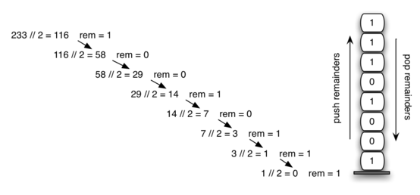
Convert base 10 to base 2

